Slide 1

Videogames 1980-2023
https://github.com/claudiamattes98/videogames_final_project
Final Project „DH Tools and Methods“
Claudia Mattes, 11776443

Slide 2
Dataset
Dataset on Kaggle: https://www.kaggle.com/datasets/arnabchaki/popular-video-games-1980-2023/ (found via a Google dataset search)
open-source dataset created by webscraping backloggd.com (a website to track and review games)
Two reasons:
General interest in videogames
Lots of different data (types), to test different packages and code we learned about

Slide 3
Research interests and Methodology
Lots of data cleaning
Visualizing the data with mathplotlib etc.
Webscraping: more data on the video game companies, plotting with geopandas
Prompt engineering for translations using OpenAI
NLP: topic analysis, sentiment analysis with NLTK, gensim etc.

Slide 4
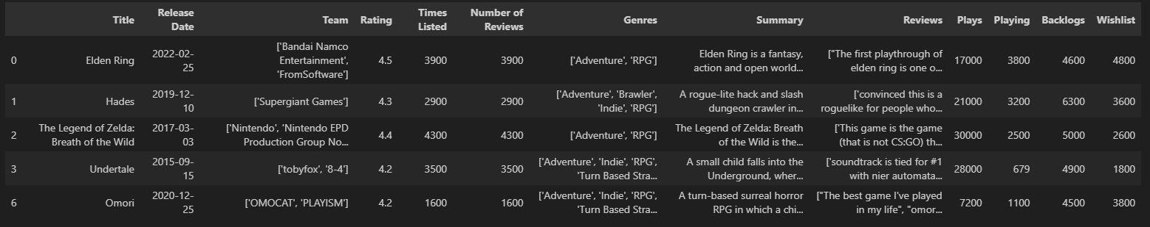
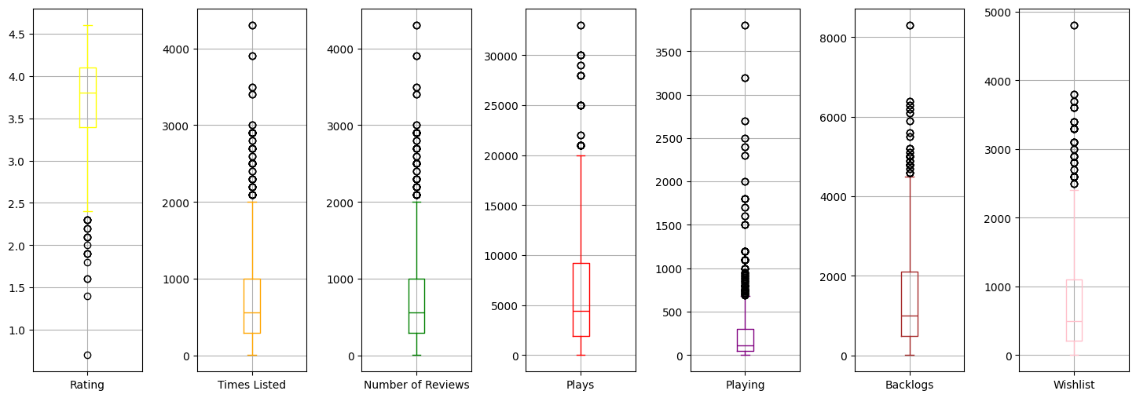
→ Genres and Teams in the dataframe: extracting the singular genres and teams from the dataframe columns

Slide 5
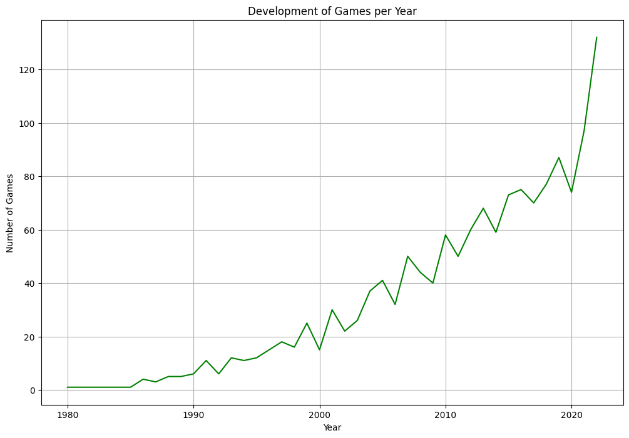
Games per Year
https://github.com/claudiamattes98/videogames_final_project/blob/main/EDA.ipynb
Continuous growth over the years
But: also data bias, the website only retroactively looked at some games (the more popular games

Slide 6
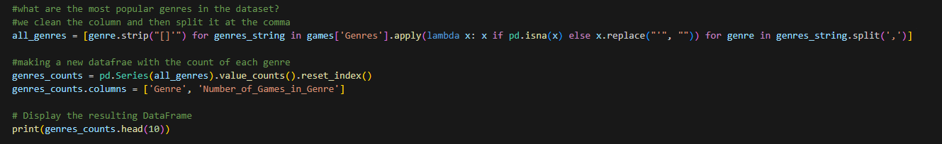
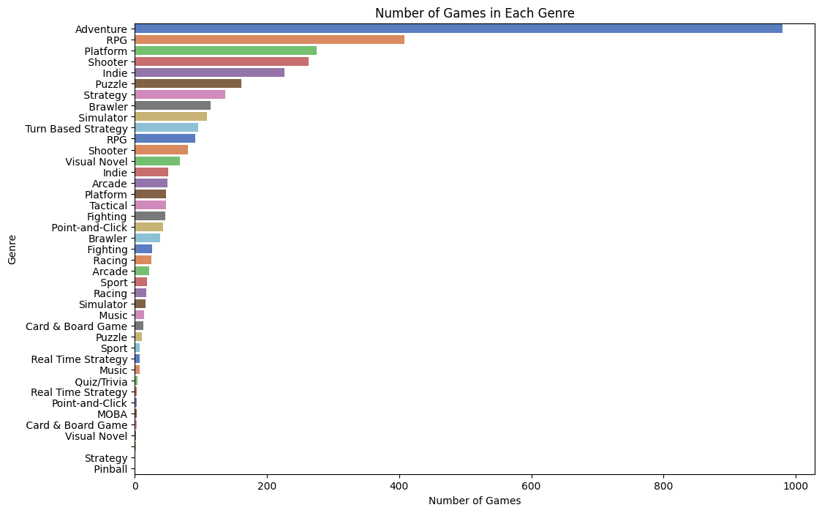
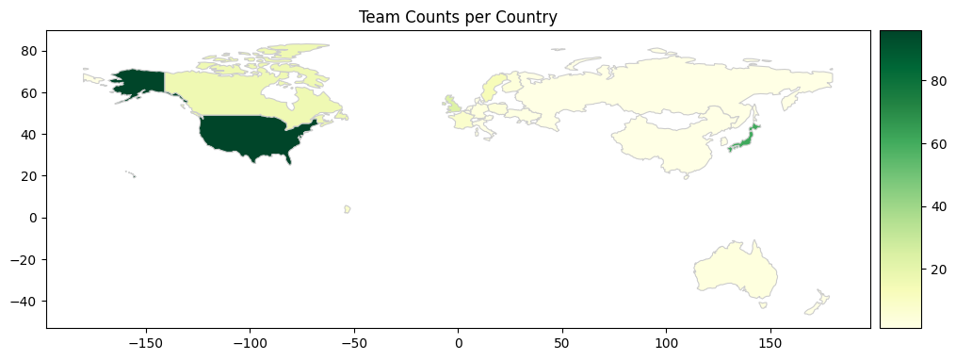
Teams and Genres in the dataframe

Slide 7
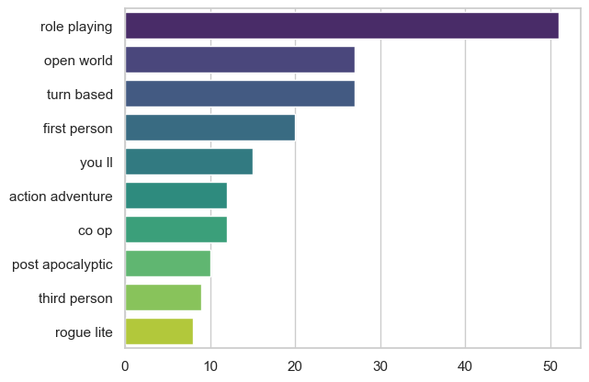
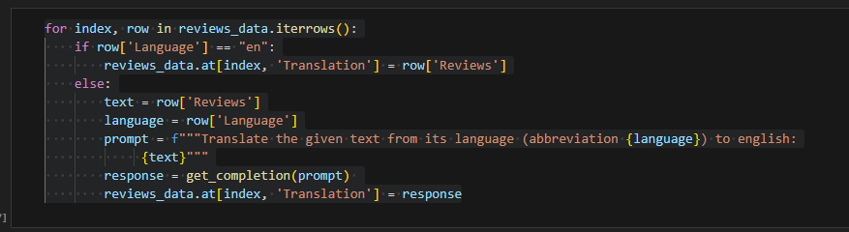
NLP I
NLP with RPG Game Summaries
Nltk Ngrams: what are RPG games about?
Game Reviews: not just english
but different languages (detect_language)
Translating with openAI

Slide 8
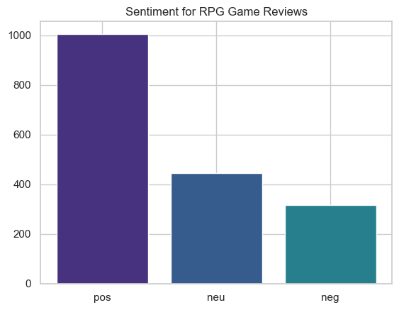
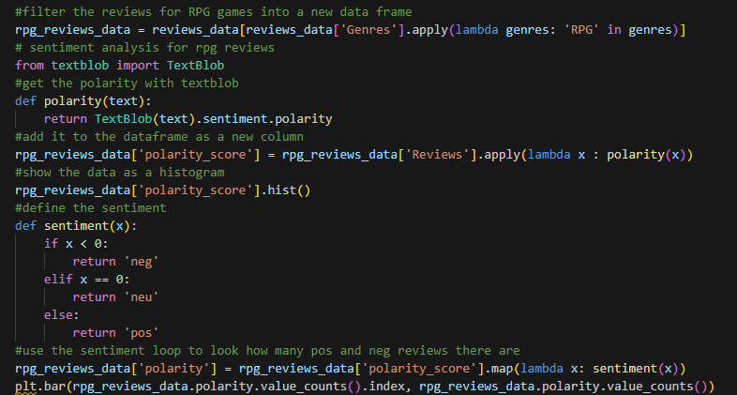
NLP II
Sentiment Analysis for the RPG game reviews with textblob
Still to do: Word embeddings with spaCy and TSNE

